Slide 1

CS 188: Artificial Intelligence
Introduction
Instructors: Stuart Russell and Dawn Song
Notes:
Please retain proper attribution and the reference to ai.berkeley.edu. Thanks!

Slide 2





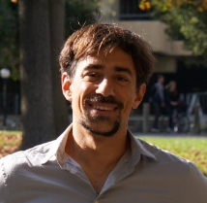






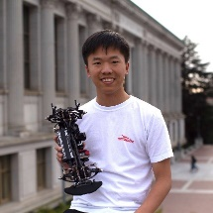


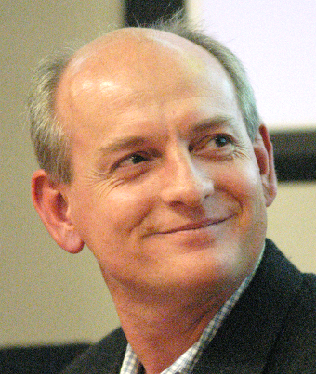


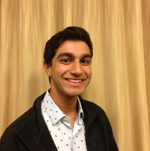

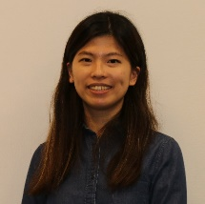
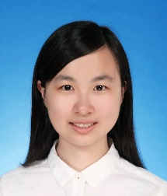

Course Staff
Professors
GSIs
Albert Yu | Angela Liu | Carl Qi | Daniel Filan | Dimitris Papadimitriou | Emma Tao | Jeffrey Tao
Jennifer Grannen | Jiaheng Zhang | Jocelyn Chen | Jonathan Yang | Mesut Yang | Nikita Samarin | Regina Wang
Robert Lin | Ryan Koh | Saagar Sanghavi | Tiancheng Xie | Wendy Lin | Xinyun Chen | Yanlai Yang
Dawn Song
Stuart Russell

Slide 3
Course Information
Communication:
Announcements, questions on Piazza
Staff email: cs188@berkeley.edu
Office hours:
Stuart: Monday 9-10.30, Thursday 1-2
Dawn: Tuesday 4-5pm from March 15
Sections start next week
Work:
Projects (25%), homework (10% + 10%)
P0 (Python) due 1/22, HW0 (math) due 1/25
Midterm (20%), final (35%)
Participation up to 1% extra (be nice!)
Fixed grading scale (85% A, 80% A-, etc.)
http://inst.cs.berkeley.edu/~cs188
Notes:
new modality, new lecturer, new edition, new timing! Lost >2 hours of class time.

Slide 4
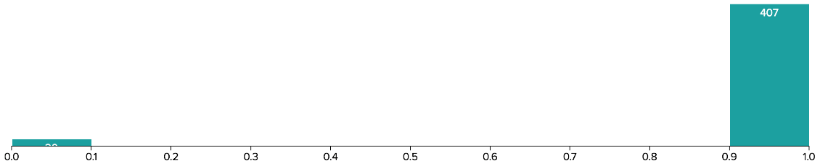
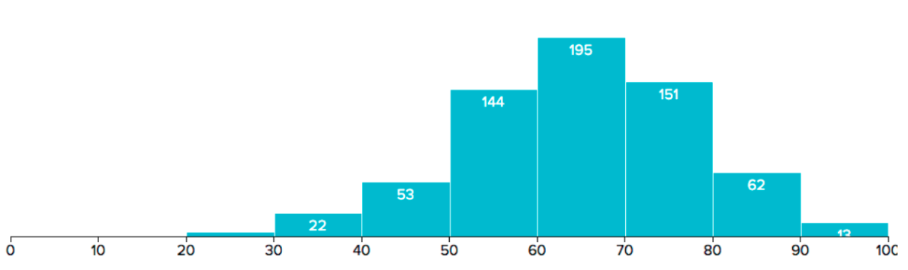
Some Historical Statistics
Homework and projects: instruction (iterate/learn till you nailed it)
Exams: assessment
Notes:
With 100% on HW, projects; 73% on exams is enough for an A

Slide 5
Course Information
Prerequisites:
CS 61A, CS 61B, CS 70 (or equivalent)
There will be some math and some programming
Work and Grading:
~6 programming projects (25%): Python, groups of 1 or 2
~11 real homework assignments (20%) (electronic + written)
One midterm (20%), one final (35%)
Fixed grading scale (85% A, 80% A-, etc.)
Participation (class, section, Piazza, contests) can help on margins
Academic integrity policy

Slide 6
Exam Dates
Midterm: March 10th, (probably) 7:00pm-9:00pm PT
Alternate: May 13 midnight-2am PT
Final: May 12th, 7.00pm-10.00pm PT
Alternate: May 13 11.30am-2.30pm PT
For alternate times, complete form: conflict, time zone

Slide 7
Discussion Section
Topic: review / warm-up exercises / questions not handled in class
There will also be recorded videos of how to think through the solution process
Currently, none of you are assigned to sections
You can attend any section, but we may do load-balancing
Sections begin next week (1/25).

Slide 8
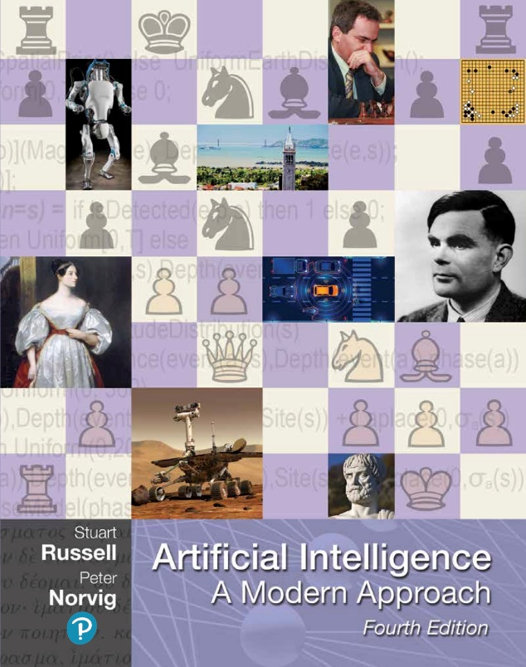
Textbook
Russell & Norvig, AI: A Modern Approach, 4th Ed.
(sorry!)

Slide 9


Instruction vs. Assessment
Our experience: these two goals don’t mix
Lecture / Section / OH / Piazza / Homework / Projects are instruction
collaborative, work until success (but please no spoilers, no cheating)
Exams are assessment
on your own
Instruction
Grow knowledge, collaborate, work until success
Assessment
Measure knowledge and ability to deploy

Slide 10
Announcements This Week
Important this week:
Check out website: https://inst.eecs.berkeley.edu/~cs188 (has links to homework, projects)
Register on Gradescope and Piazza (check your email for links)
HW0: Math self-diagnostic is online now (due on Monday 1/25 at 11:59pm)
P0: Python tutorial is online now (due on Friday 1/22 at 11:59pm)
Instructional accounts: if you want one, go to https://inst.eecs.berkeley.edu/webacct
Also important:
Waitlist: See https://eecs.berkeley.edu/resources/undergrads/cs/degree-reqs/enrollment-policy or google “Berkeley EECS enrollment”

Slide 11
Policies (see website)
For online lectures:
Camera on, mic off
Please do ask questions: “Hand Up” or write in Chat
Will occasionally split into multiple zoom rooms for collaborative problem-solving
We (staff) are here to help
Please do observe academic integrity policies!
Please don’t exclude your fellow students!

Slide 12
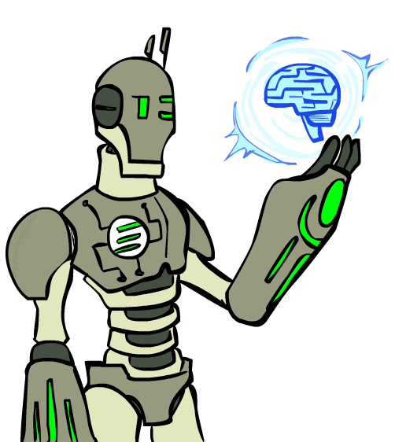
Today
What is artificial intelligence?
Past: how did the ideas in AI come about?
Present: what is the state of the art?
Future: will robots take over the world?

Slide 13
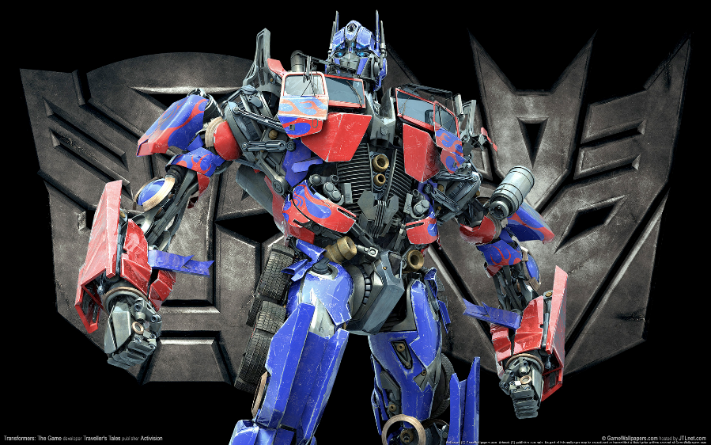
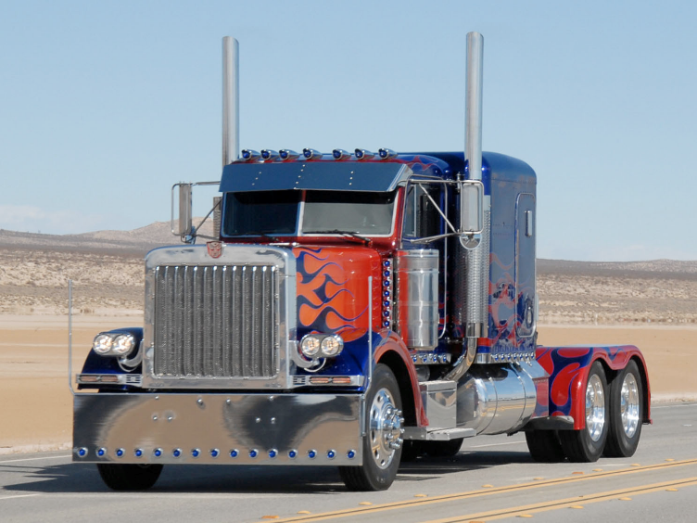
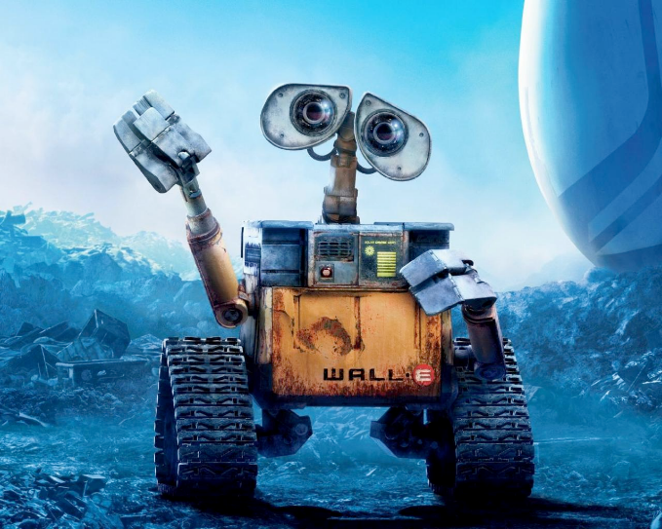
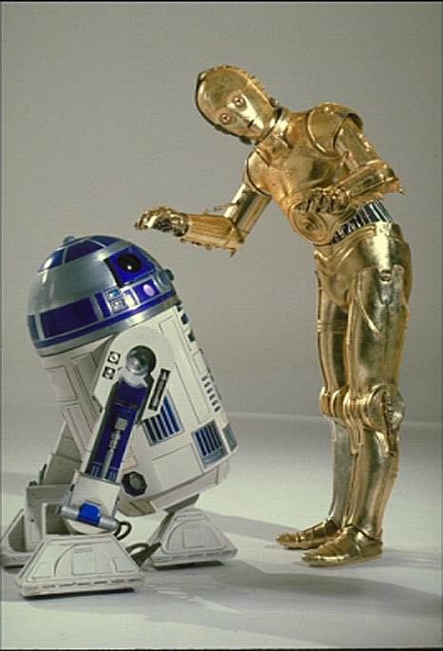

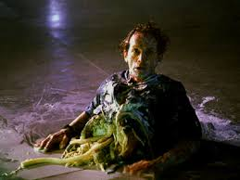
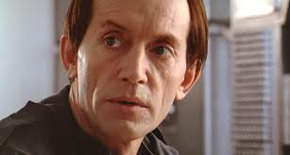
Movie AI
Notes:
You can type into chat when you recognize the robot (just once!)
C3PO, what does he do? Essentially google translate, (but with anxiety disorder!)
R2D2 – what does he do, yeah, not so sure
These are all good

Slide 14
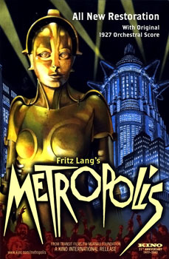
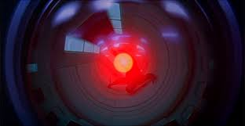
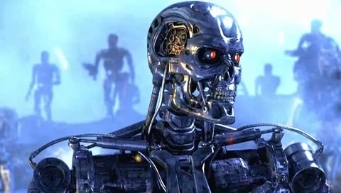
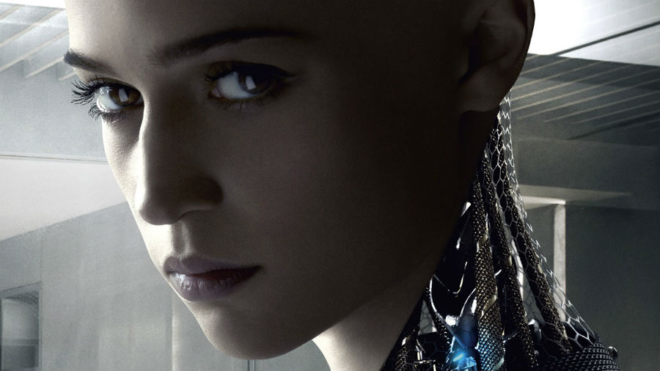

Movie AI
Notes:
Futura/Maria
HAL
Termainator
Agent Smith
Ava

Slide 15


Slide 16
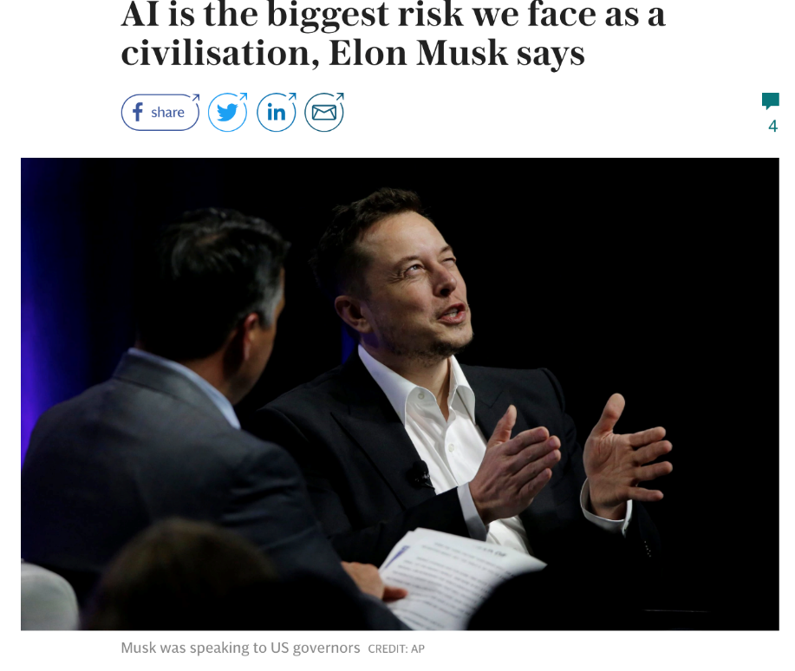
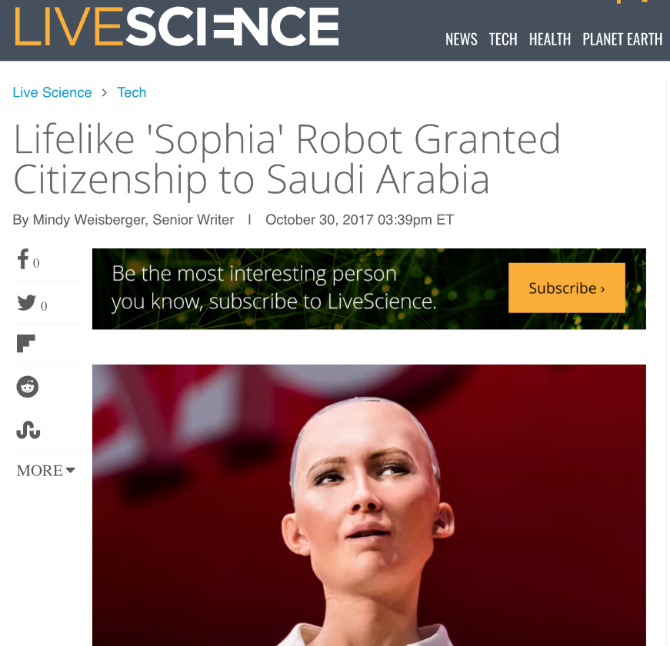
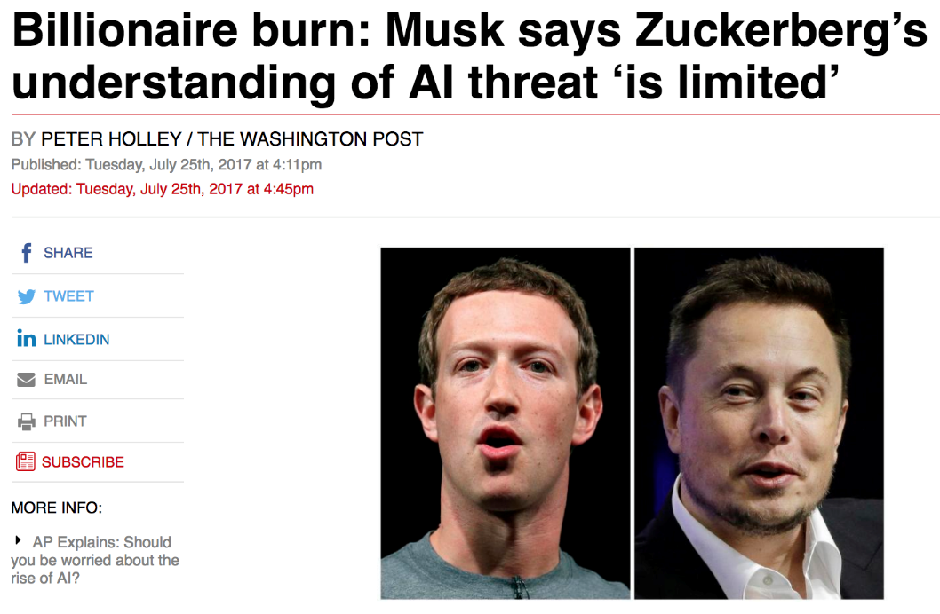
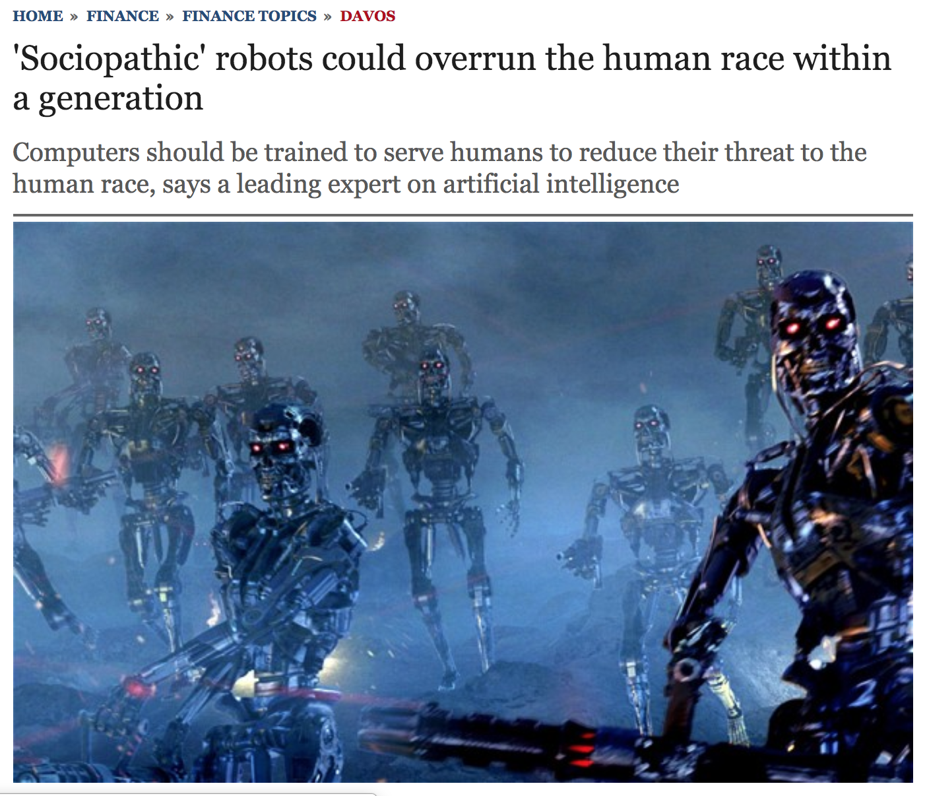
News AI

Slide 17

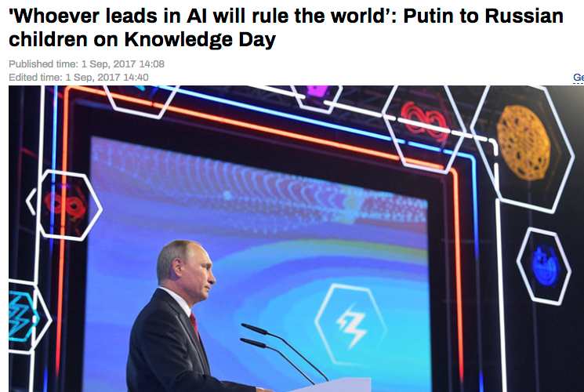

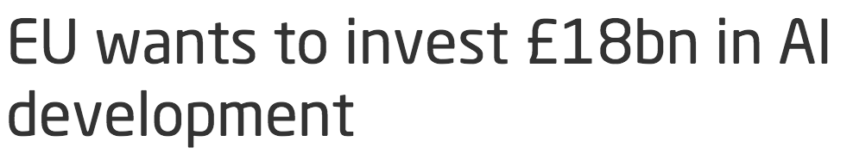

News AI

Slide 18
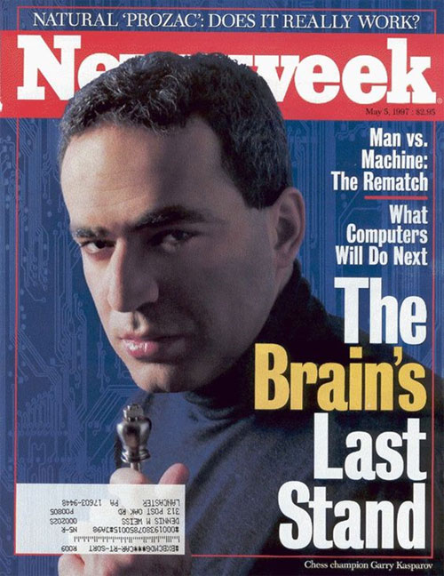
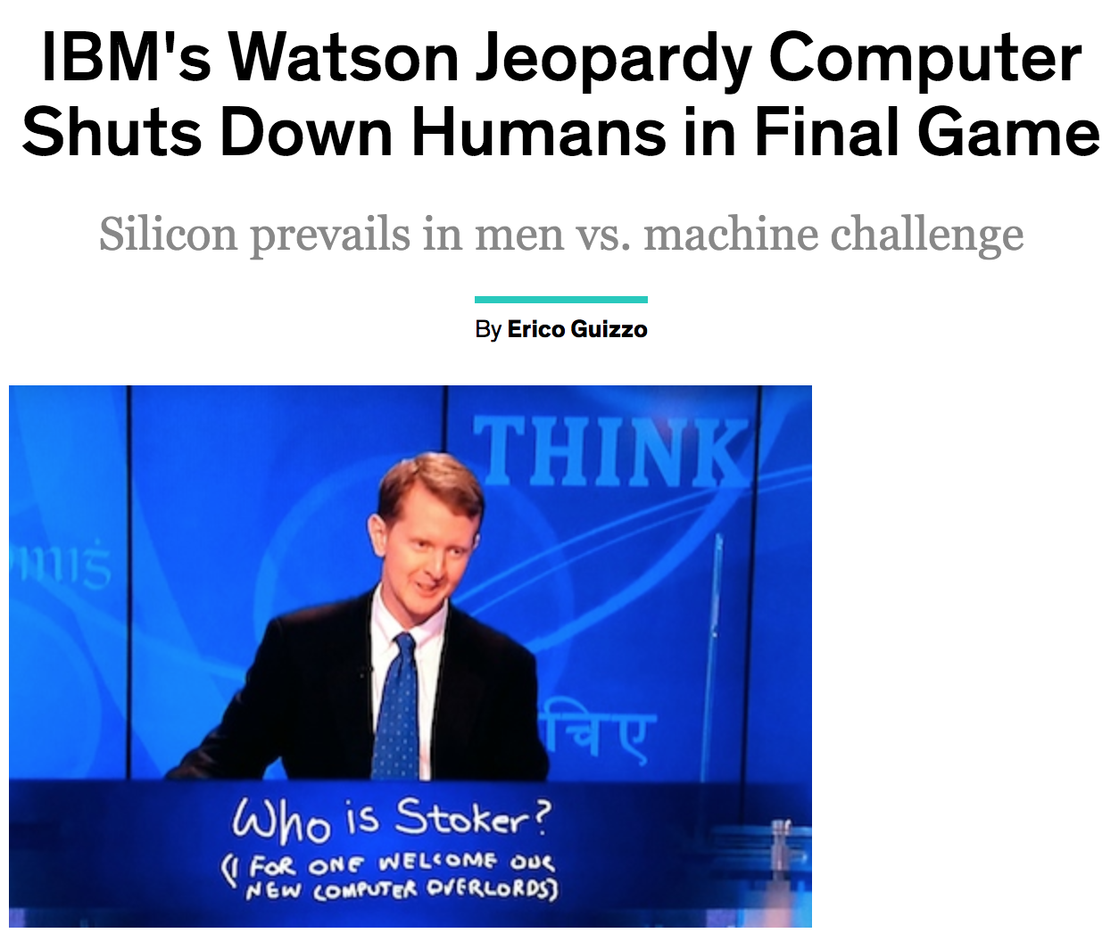

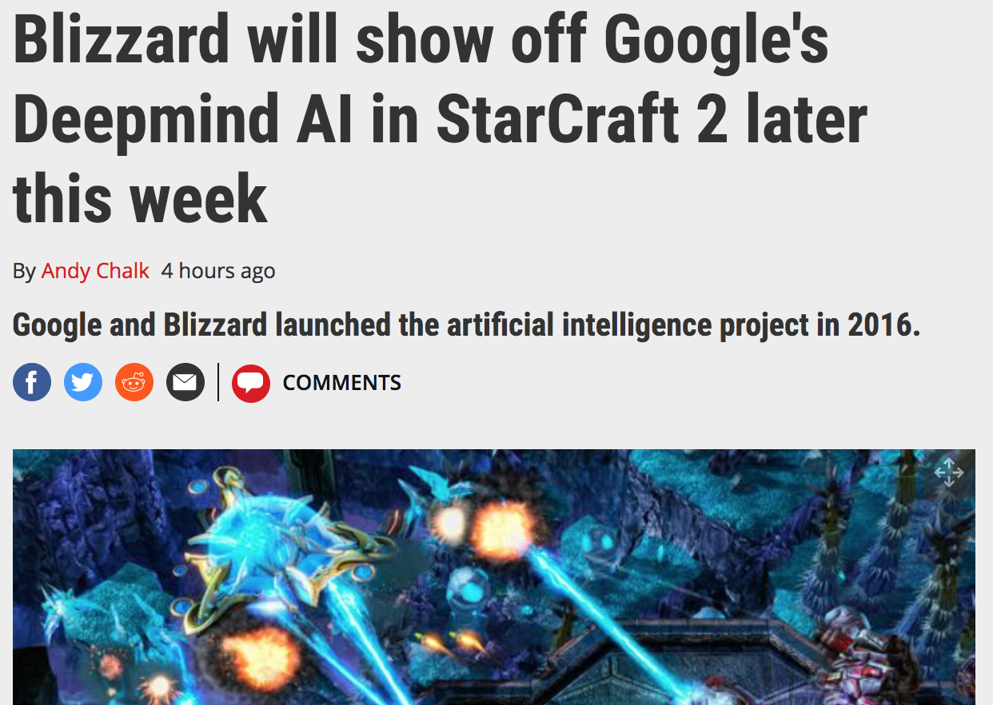
News AI

Slide 19
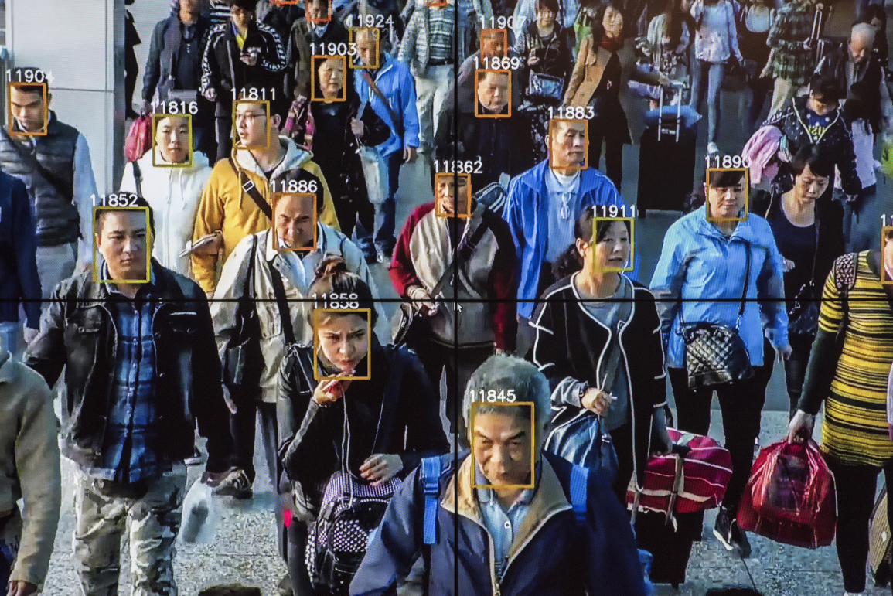
Real AI

Slide 20
Notes:
Robots help nurses in hospitals deliver stuff to different rooms

Slide 21
Notes:
Or drones that record cooll videos of us as we do outdoor activities
Or in my case,

Slide 22
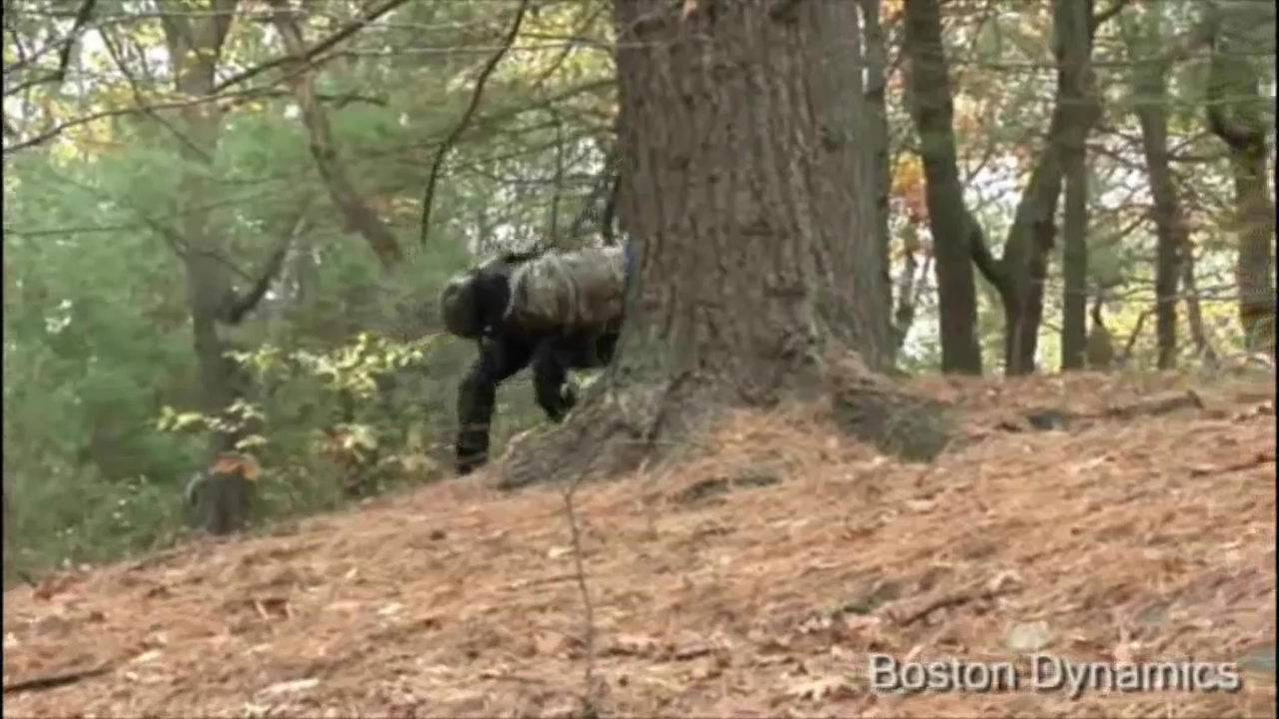

Slide 23
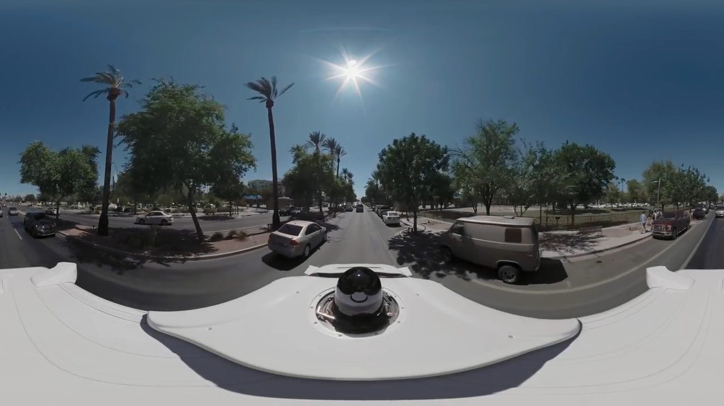

Slide 24
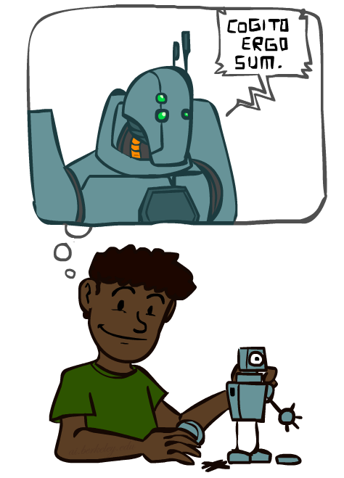
A (Short) History of AI
Demo: HISTORY – MT1950.wmv

Slide 25
A short prehistory of AI
Prehistory:
Philosophy (reasoning, planning, learning, science, automation)
Mathematics (logic, probability, optimization)
Neuroscience (neurons, adaptation)
Economics (rationality, game theory)
Control theory (feedback)
Psychology (learning, cognitive models)
Linguistics (grammars, formal representation of meaning)
Aristotle: For if every instrument could accomplish its own work, obeying or anticipating the will of others . . . if, in like manner, the shuttle would weave and the plectrum touch the lyre without a hand to guide them, chief workmen would not want servants, nor masters slaves
Near miss (1842):
Babbage design for universal machine
Lovelace: “a thinking machine” for “all subjects in the universe.”

Slide 26
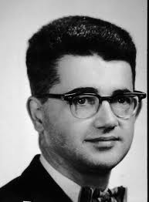
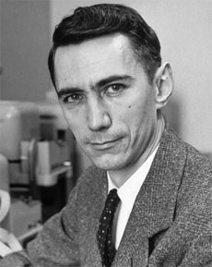
AI’s official birth: Dartmouth, 1956
“An attempt will be made to find how to make machines use language, form abstractions and concepts, solve kinds of problems now reserved for humans, and improve themselves. We think that a significant advance can be made if we work on it together for a summer.”
John McCarthy and Claude Shannon
Dartmouth Workshop Proposal

Slide 27


Slide 28

A (Short) History of AI
1940-1950: Early days
1943: McCulloch & Pitts: Boolean circuit model of brain
1950: Turing's “Computing Machinery and Intelligence”
1950—70: Excitement: Look, Ma, no hands!
1950s: Early AI programs: chess, checkers (RL), theorem proving
1956: Dartmouth meeting: “Artificial Intelligence” adopted
1965: Robinson's complete algorithm for logical reasoning
1970—90: Knowledge-based approaches
1969—79: Early development of knowledge-based systems
1980—88: Expert systems industry booms
1988—93: Expert systems industry busts: “AI Winter”
1990— 2012: Statistical approaches + subfield expertise
Resurgence of probability, focus on uncertainty
General increase in technical depth
Agents and learning systems… “AI Spring”?
2012— ___: Excitement: Look, Ma, no hands again?
Big data, big compute, deep learning
AI used in many industries

Slide 29
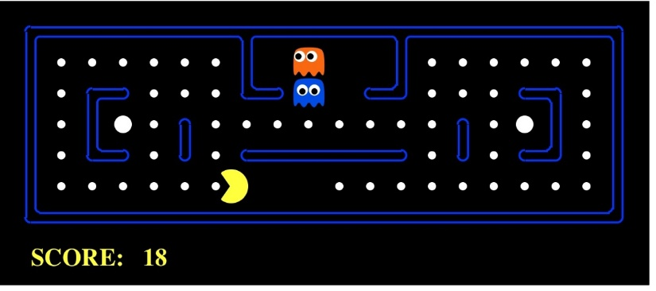
AI as Designing Rational Agents
An agent is an entity that perceives and acts.
A rational agent selects actions that maximize its expected utility.
Characteristics of the sensors, actuators, and environment dictate techniques for selecting rational actions
This course is about:
General AI techniques for many problem types
Learning to choose and apply the technique appropriate for each problem
Sensors
Percepts
Agent
Environment
?
Actuators
Actions
Pac-Man is a registered trademark of Namco-Bandai Games, used here for educational purposes

Slide 30
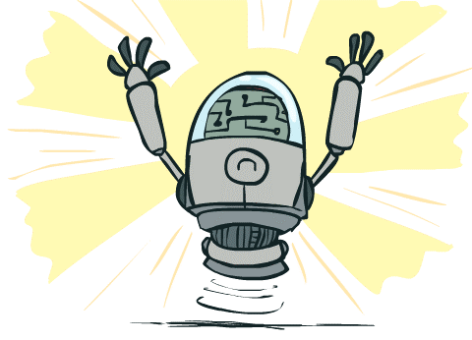
What Can AI Do?
Quiz: Which of the following can be done at present?
Play a decent game of table tennis?
Play a decent game of Jeopardy?
Drive safely along a curving mountain road?
Drive safely along Telegraph Avenue?
Buy a week's worth of groceries on the web?
Buy a week's worth of groceries at Berkeley Bowl?
Discover and prove a new mathematical theorem?
Converse successfully with another person for an hour?
Perform a surgical operation?
Translate spoken Chinese into spoken English in real time?
Fold the laundry and put away the dishes?
Write an intentionally funny story?
Notes:
Mountain road example: https://www.wired.com/2010/11/audis-robotic-car-climbs-pikes-peak/

Slide 31
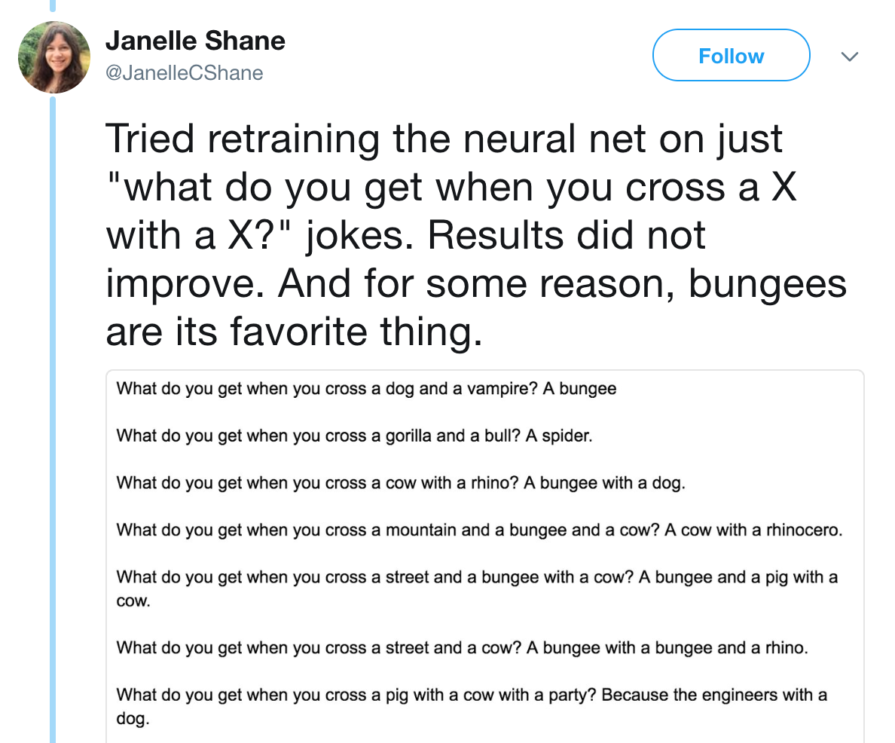
Unintentionally Funny Stories
Once upon a time there was a dishonest fox and a vain crow. One day the crow was sitting in his tree, holding a piece of cheese in his mouth. He noticed that he was holding the piece of cheese. He became hungry and swallowed the cheese. The fox walked over to the crow. The End.
[Schank, Tale-Spin, 1984]
What do you get when you cross a dog and a vampire?
A bungee
What do you get when you cross a cow with a rhino?
A bungee with a dog
What do you get when you cross a street and a cow?
A bungee with a bungee and a rhino
What do you get when you cross a pig with a cow with a party?
Because the engineers with a dog

Slide 32
Future
We are doing AI…
To create intelligent systems
The more intelligent, the better
To gain a better understanding of human intelligence
To magnify those benefits that flow from it
E.g., net present value of human-level AI ≥ $13,500T
Might help us avoid war and ecological catastrophes, achieve immortality and expand throughout the universe
What if we succeed?

Slide 33
It seems probable that once the machine thinking method had started, it would not take long to outstrip our feeble powers. … At some stage therefore we should have to expect the machines to take control

Slide 34
What’s bad about better AI?
AI that is incredibly good at achieving something other than what we really want
AI, economics, statistics, operations research, control theory all assume utility to be fixed, known, and exogenously specified
Machines are intelligent to the extent that their actions can be expected to achieve their objectives
Machines are beneficial to the extent that their actions can be expected to achieve our objectives

Slide 35
A new model for AI
1. The machine’s only objective is to maximize the realization of human preferences
2. The robot is initially uncertain about what those preferences are
3. Human behavior provides evidence about human preferences
The standard model of AI is a special case, where the human can exactly and correctly program the objective into the machine

